Slide 1
C*A*R*D
User Interface

Slide 2
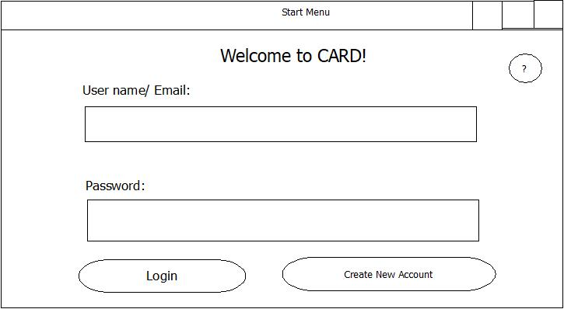
Start Screen
Notes:
Nick is doing

Slide 3
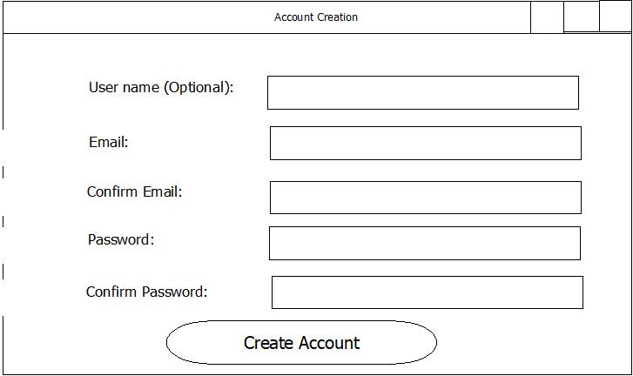
Create Account
Notes:
Nick is doing

Slide 4
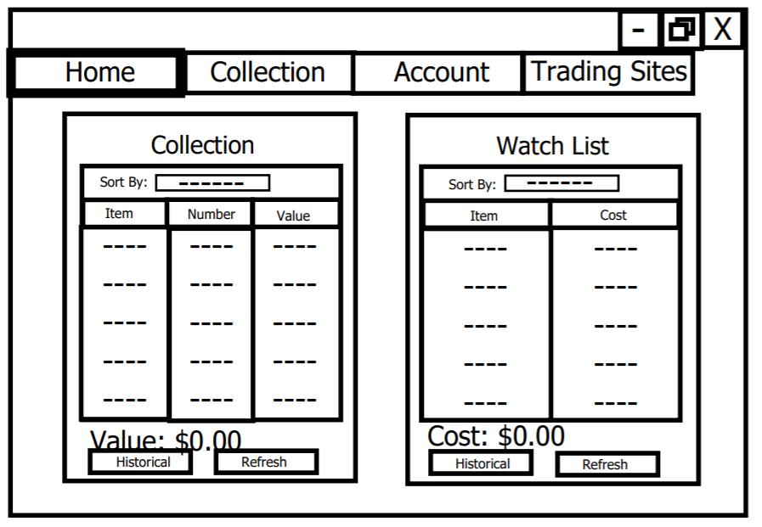
Home Screen
Notes:
Ben is Doing

Slide 5
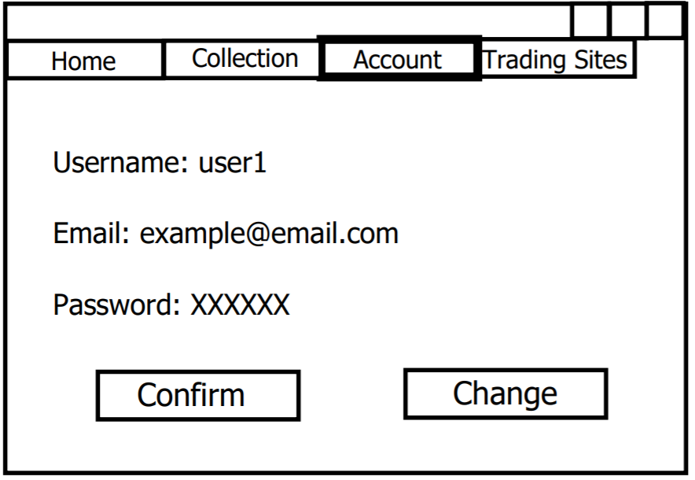
Account Screen
Notes:
Ben is Doing

Slide 6
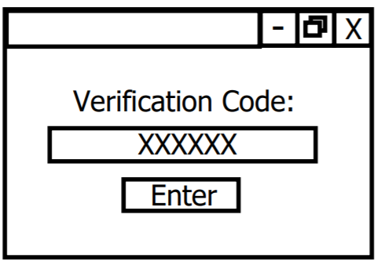
2-Step Verification
Notes:
Nick is doing

Slide 7
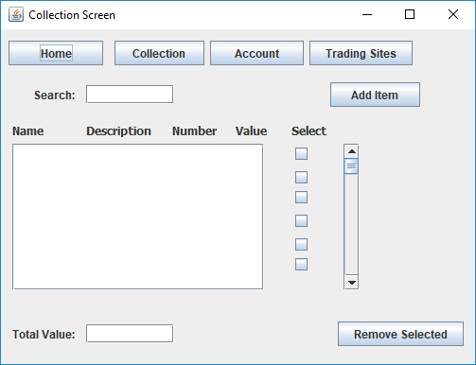
Notes:
Scrolling thingy not the best idea
Two boxes that you can move things between
Ben is Doing

Slide 8
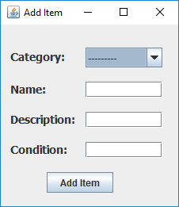
Notes:
Jay is doing

Slide 9
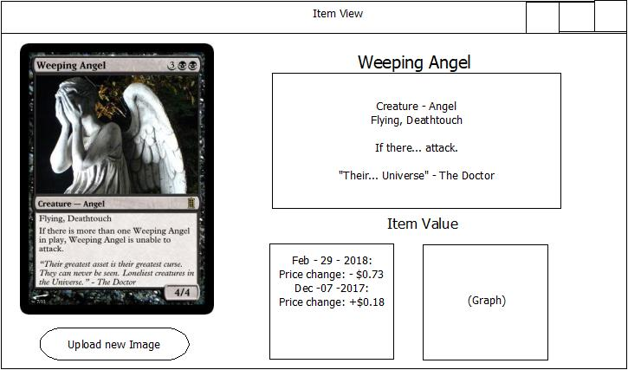
Notes:
Jay is doing

Slide 10
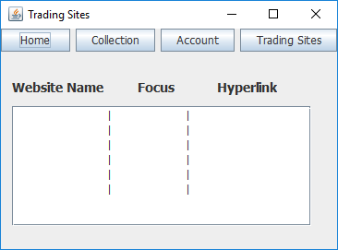
Notes:
Ben is Doing

Slide 11
